Slide 1


SKINCARE PRODUCT RECOMMENDATION SYSTEM
Department of Computer Science and Engineering
CS19643 – FOUNDATIONS OF MACHINE LEARNING
ADHARSHINI C (210701014)
AMIRDHA M (210701026)
Dr.S. Vinodkumar
Professor

Slide 2
ABSTRACT
In the vast skincare industry, choosing the right products can be challenging. Our Skincare Product Recommendation System combines machine learning and natural language processing to offer personalized recommendations. By analyzing product descriptions, reviews, and ingredient lists, our system considers user-specific factors like skin type, tone, eye color, and hair color. Insights from category analysis and user demographics enhance the accuracy of suggestions. We use text preprocessing and visualizations like word clouds to identify review trends. Machine learning models, including Naive Bayes, Logistic Regression, and SGD Classifier, ensure recommendation accuracy. Content-based filtering further refines suggestions based on user ratings and ingredient similarity, empowering consumers to make informed skincare choices for optimal results.

Slide 3
EXISTING SYSTEM
Consumers in the skincare sector often rely on manual selection methods, recommendations from friends, or trial-and-error experiences. Online platforms offer numerous products with descriptions, reviews, and ratings, aiding informed decisions. Professional consultations from dermatologists and estheticians provide tailored advice but can be costly and inaccessible. Beauty subscription services use personalized questionnaires to curate products, while mobile apps and virtual try-on tools offer digital testing and recommendations. Despite these options, existing systems often lack the customization and data-driven insights needed to meet consumers' diverse needs effectively.

Slide 4
PROPOSED SYSTEM
Overview: Revolutionizes skincare product selection using machine learning and natural language processing.
Data Processing:
Preprocesses and analyzes product descriptions, reviews, and user demographics.
Uses techniques like cleaning, tokenization, and TF-IDF feature extraction.
Algorithms:
Employs Naive Bayes, Logistic Regression, and SGD Classifier.
Forecasts skincare categories and identifies desirable ingredients.
Personalization:
Integrates user characteristics such as skin type, tone, eye color, and hair color.
Enhances recommendation relevance and accuracy.

Slide 5
PROPOSED SYSTEM
Evaluation:
Uses precision, recall, and F1-score to ensure recommendation accuracy.
Development Environment:
Built in Python with libraries like Scikit-learn, NLTK, and Pandas.
Runs in Jupyter Notebook for interactive model development and evaluation.
Scalability:
Designed for scalability and adaptability.
Can be deployed as a web application or integrated into existing skincare platforms.
Benefits: Provides seamless, personalized skincare advice across multiple devices and platforms.

Slide 6
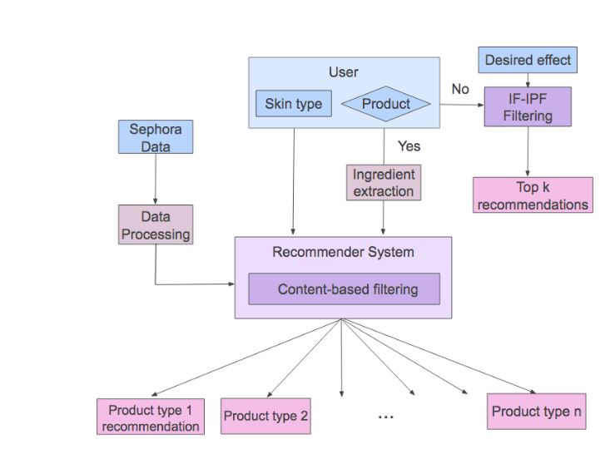
SYSTEM ARCHITECTURE

Slide 7
LIST OF MODULES
DATA COLLECTION MODULE
DATA PREPROCESSING MODULE
FEATURE ENGINEERING MODULE
MACHINE LEARNING MODELS MODULE
USER INTERFACE MODULE

Slide 8
DATA COLLECTION MODULE
Overview:
Accesses and retrieves skincare product data from the Sephora dataset in formats like CSV, JSON, and APIs.
Includes understanding dataset structure, storing data in memory, and performing exploratory data analysis (EDA).
Functionality:
Dataset Access: Connects to the Sephora dataset, manages authentication, authorization, and data retrieval for secure and efficient access.
Data Retrieval: Retrieves product information, querying attributes like product names, descriptions, ingredient lists, prices, user reviews, and ratings.
Web Scraping: Uses web scraping to gather data when APIs are unavailable, parsing HTML pages and extracting relevant sections.
Data Parsing and Transformation: Parses and transforms retrieved data into structured formats (e.g., pandas DataFrames) for analysis and modeling.
Exploratory Data Analysis (EDA): Summarizes statistics, displays data distributions, identifies patterns or trends, and detects data quality issues.

Slide 9
DATA PREPROCESSING MODULE
Overview:
Cleans, transforms, and prepares raw data for analysis and model training, ensuring data quality, consistency, and usability.
Functionality:
Handling Missing Values: Identifies and addresses missing data using imputation (mean, median, mode, KNN) or deletion methods.
Data Cleaning: Removes duplicates, corrects inconsistencies, and filters out erroneous data points.
Normalization and Standardization: Scales numerical features to a common range or adjusts them to have a mean of 0 and standard deviation of 1 for better model performance.
Text Preprocessing: Standardizes text formats, removes special characters and stop words, tokenizes text, and applies stemming and lemmatization.
Encoding Categorical Variables: Converts categorical data (e.g., product categories, brands) into numerical representations using one-hot, label, or ordinal encoding.
Quality Assurance: Ensures data quality and integrity through validation, consistency checks, and data profiling.

Slide 10
FEATURE ENGINEERING MODULE
Overview:
Extracts informative features from the dataset to accurately represent user preferences and product characteristics for skincare recommendations.
Functionality:
Domain Knowledge Integration: Utilizes skincare domain expertise to identify relevant features for recommendations.
Feature Selection: Employs statistical and correlation analysis to retain significant features, removing redundant or irrelevant ones.
Textual Feature Extraction: Uses NLP techniques like tokenization, stemming, lemmatization, and sentiment analysis to capture semantic information from product descriptions, ingredient lists, and reviews.
Numerical Feature Engineering: Enhances predictive power of ratings, prices, and user engagement metrics through binning, scaling, and aggregation.
Categorical Feature Encoding: Converts categorical variables (e.g., product categories, brands) into numerical form using one-hot, label, and target encoding.
Feature Combination and Interaction: Creates new features by combining or interacting with existing ones, including interaction terms and polynomial features.

Slide 11
MACHINE LEARNING MODELS MODULE
Overview:
Uses various algorithms to learn patterns from the pre-processed dataset and provide personalized skincare recommendations.
Functionality:
Model Selection:
Collaborative Filtering: Analyzes user-item interactions to find similar users or products for recommendations.
Content-Based Filtering: Recommends products similar to those the user has interacted with, based on product attributes and user profiles.
Matrix Factorization: Decomposes the user-item interaction matrix to capture latent factors influencing preferences.
Ensemble Methods: Combines multiple recommendation strategies to enhance accuracy.
Model Training: Trains models on pre-processed data, integrating user preferences, product attributes, and past interactions.
Evaluation and Validation: Assesses model performance using metrics like accuracy, precision, recall, and F1 score. Utilizes holdout validation and cross-validation for robustness. Hyperparameter tuning optimizes model parameters to avoid overfitting.

Slide 12
USER INTERFACE MODULE
Overview:
An interactive platform enabling users to input skincare preferences and receive personalized product recommendations.
Functionality:
Interface Design: Creates a user-friendly interface with intuitive forms, dropdown menus, and interactive widgets for easy input of skincare preferences.
Product Display: Presents recommended skincare products from the Sephora dataset in a visually appealing manner, showcasing detailed product information, ratings, reviews, and purchase options.
Integration: Seamlessly integrates with the recommendation engine to deliver personalized suggestions and ensures a consistent user experience across devices.

Slide 13
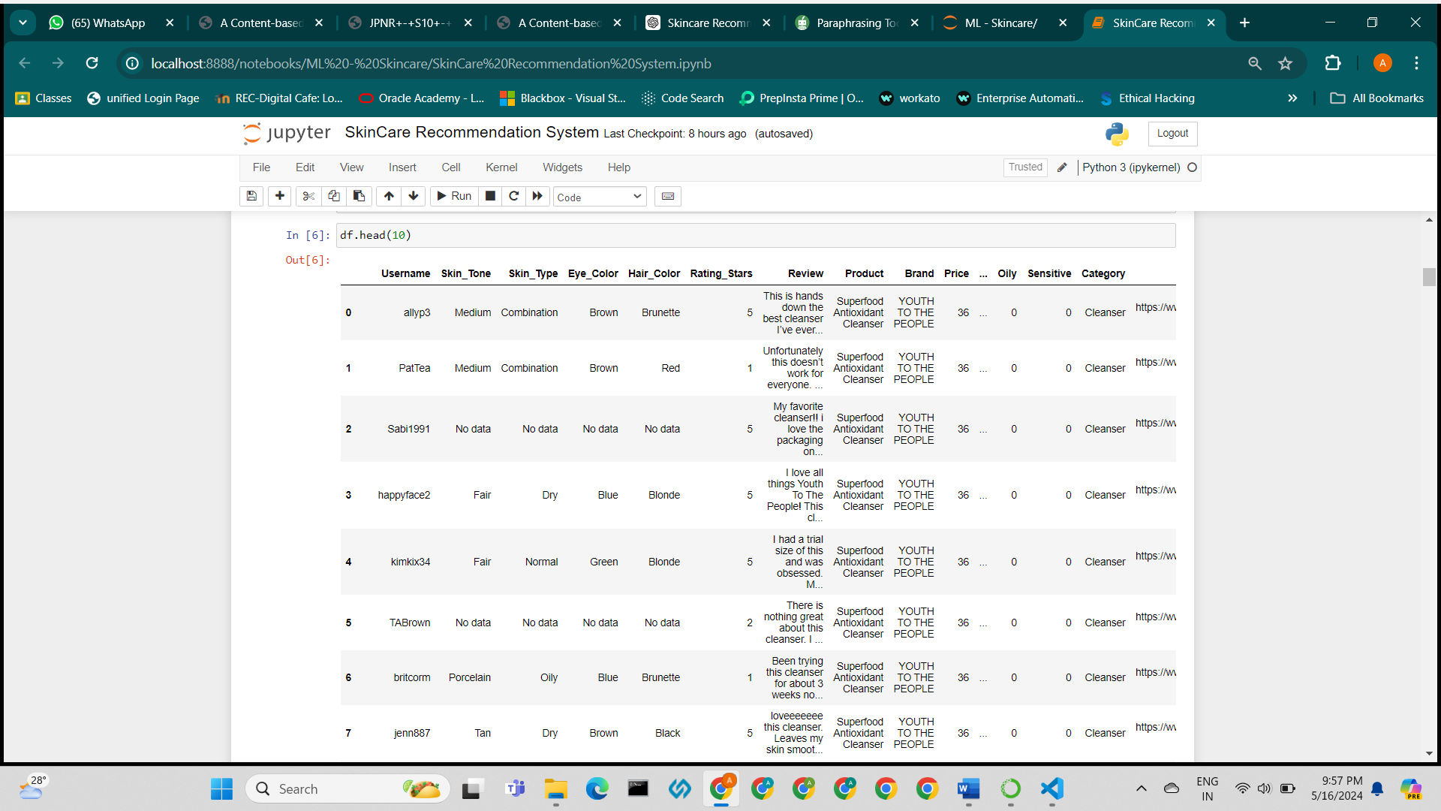
IMPLEMENTATION
IMPORTING DATASET

Slide 14
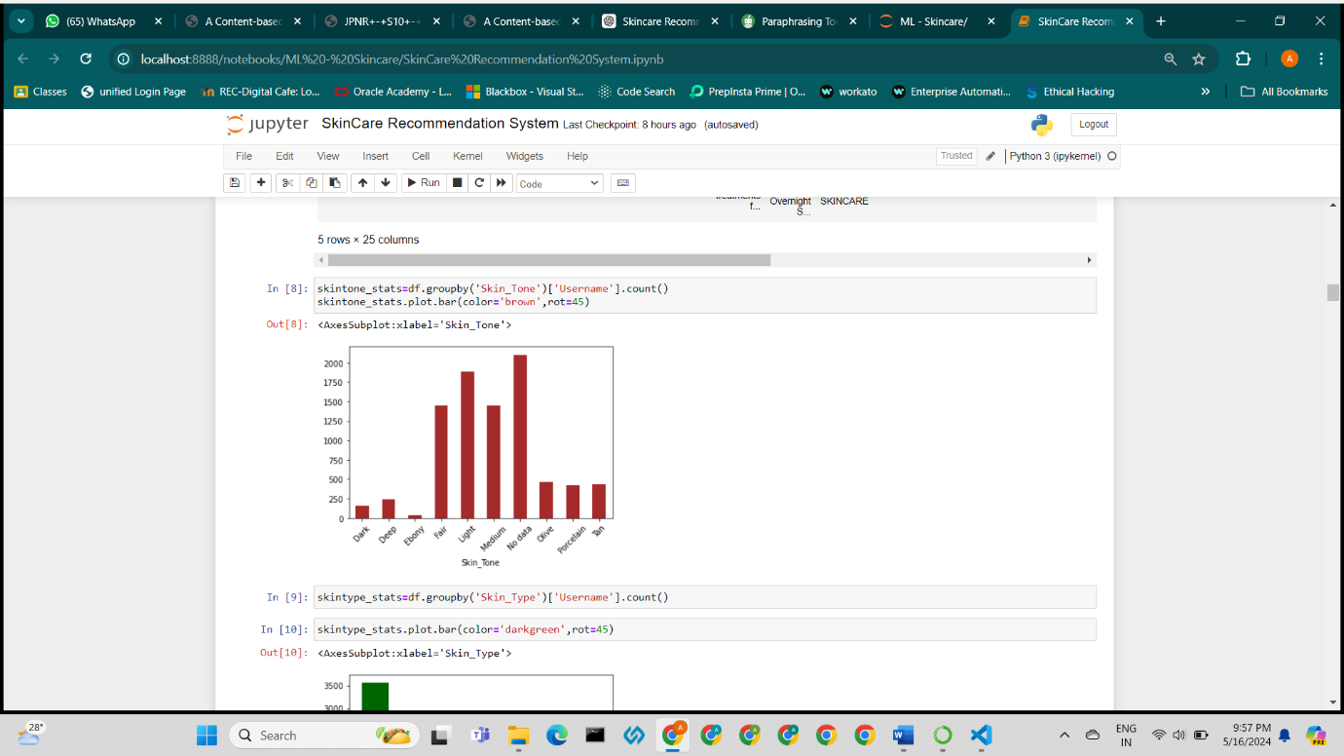
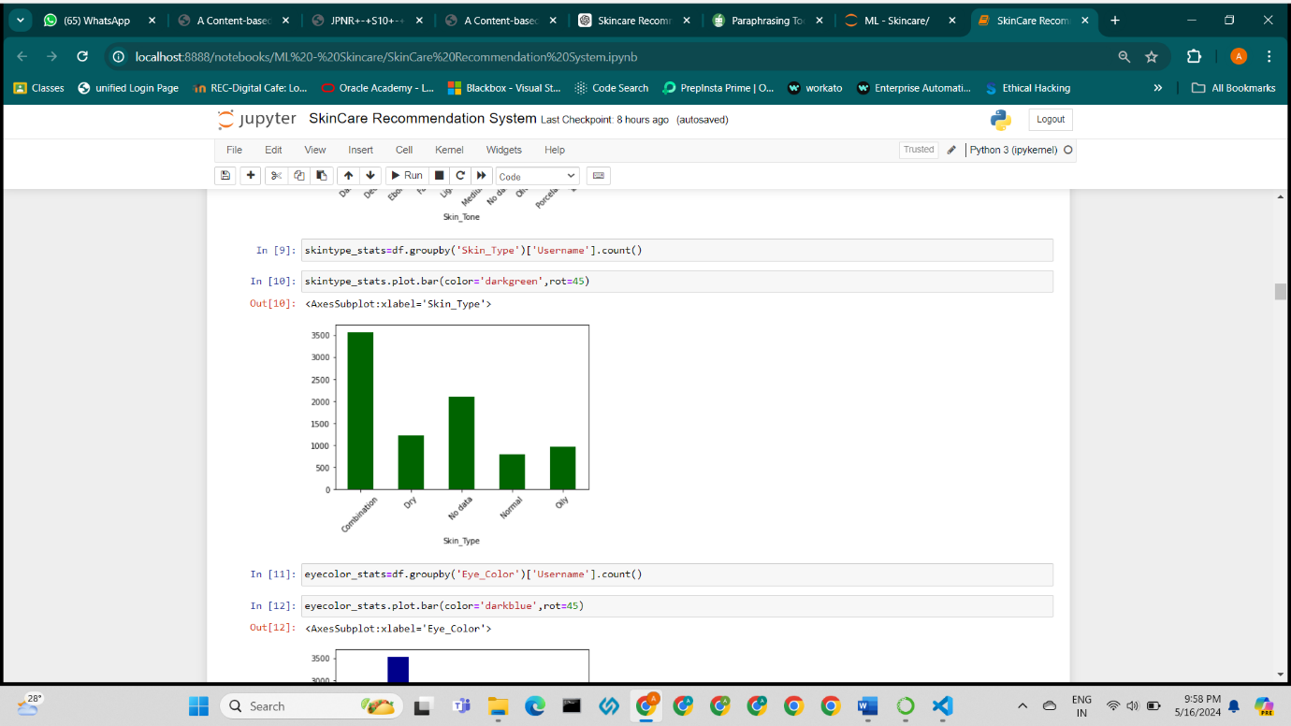
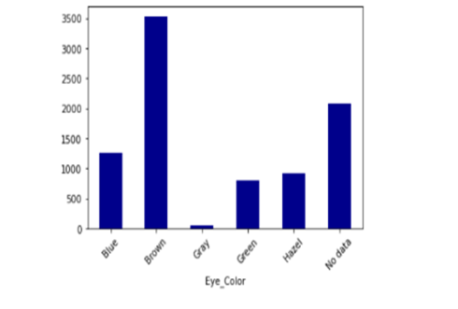
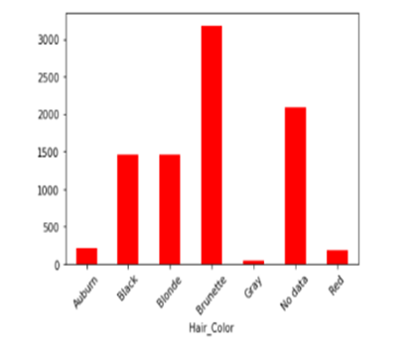
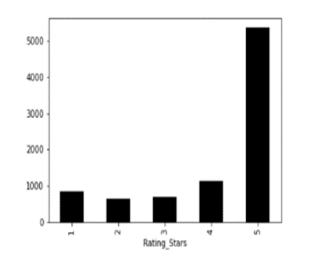
IMPLEMENTATION

Slide 15
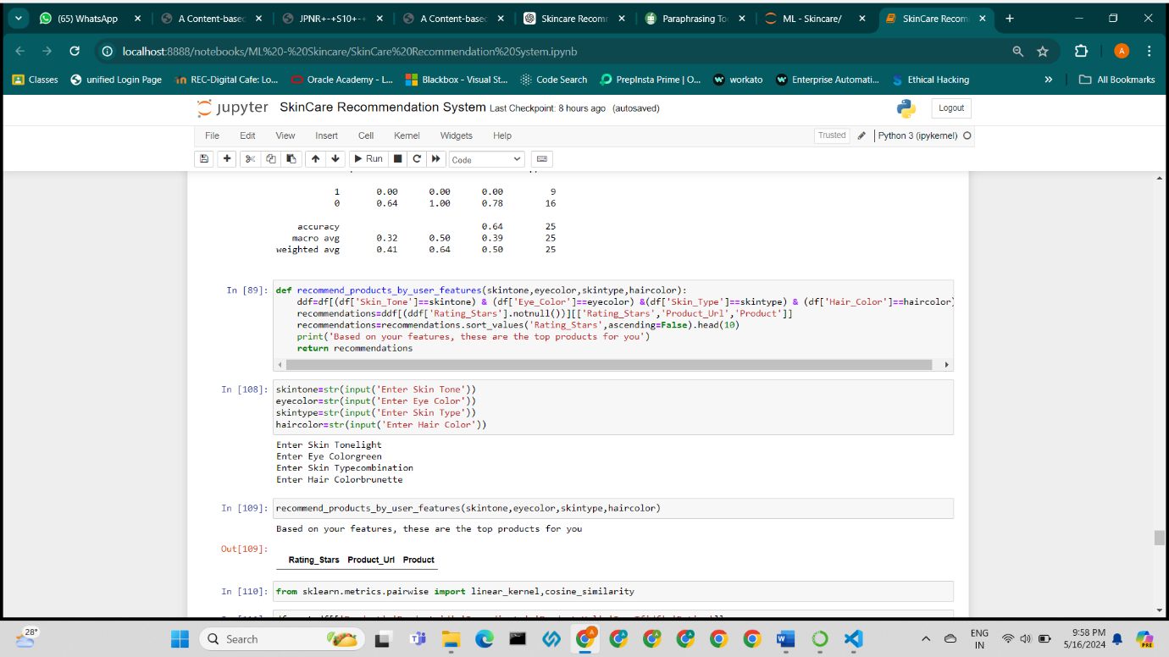
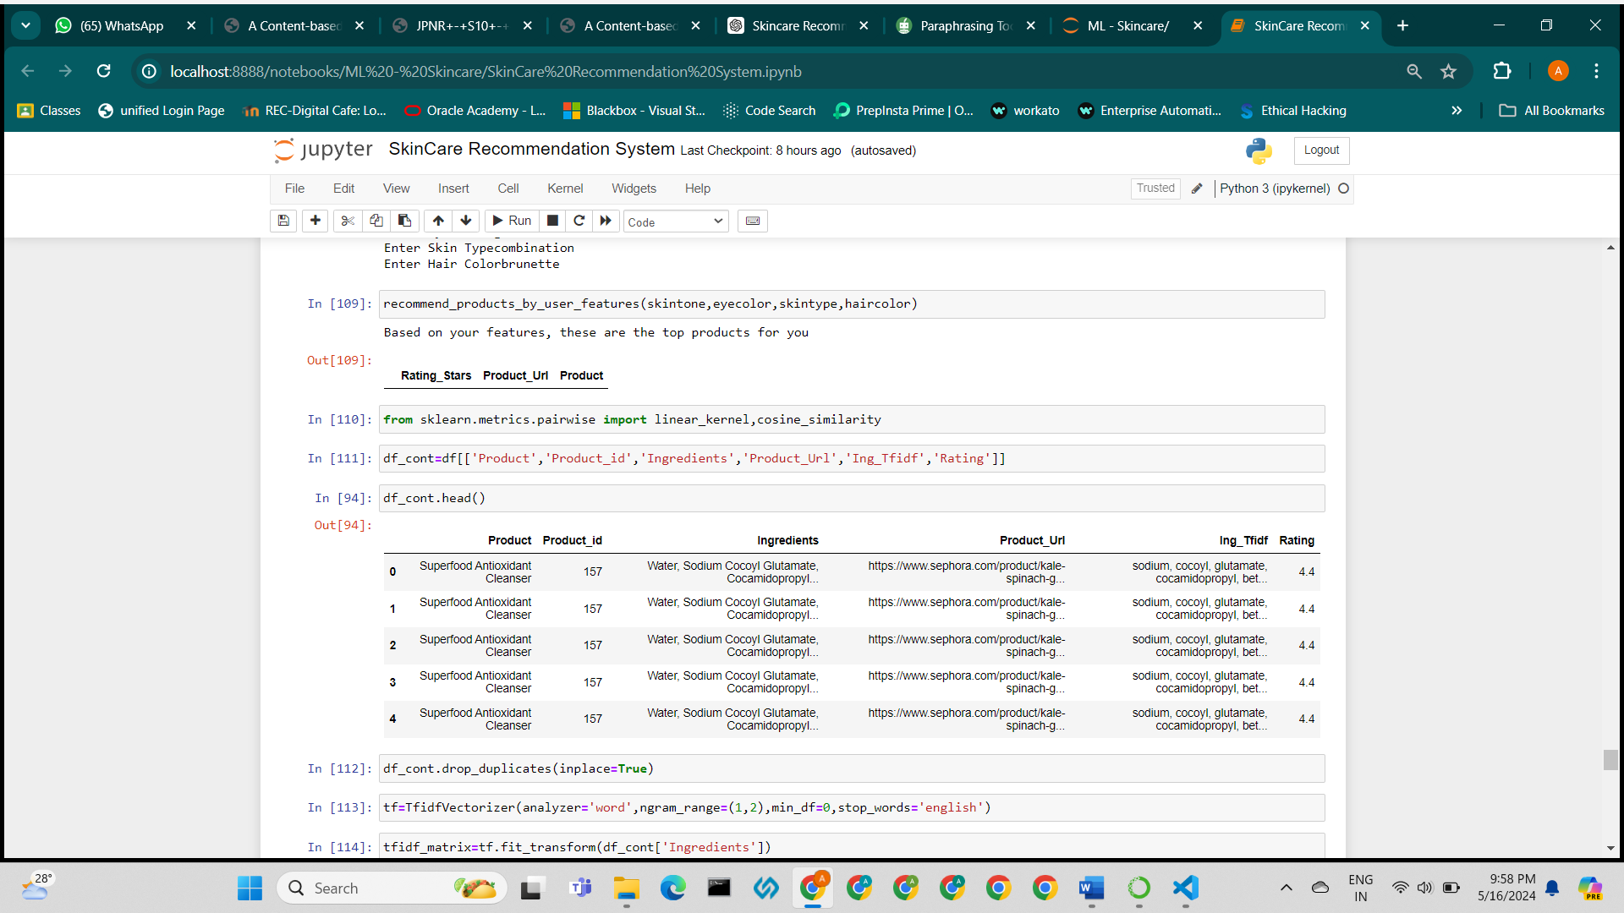
IMPLEMENTATION

Slide 16
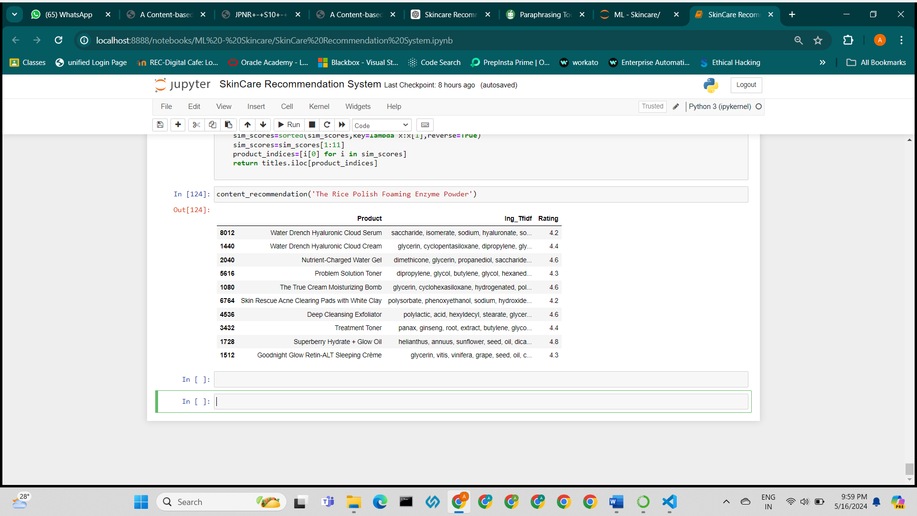
IMPLEMENTATION

Slide 17
CONCLUSION
In conclusion, the Skincare Product Recommendation System represents a significant advancement in personalized skincare solutions. By integrating state-of-the-art machine learning algorithms, meticulous data preprocessing techniques, and intuitive user interface design, the system effectively navigates the vast landscape of skincare products. It provides consumers with tailored recommendations based on their unique skincare requirements and preferences, leveraging insights from user input, product attributes, and previous interactions. This project addresses common challenges such as information overload and decision paralysis, offering a streamlined platform for skincare research and purchases. With its robust architecture and user-centric design, the system showcases the transformative potential of data-driven technologies in revolutionizing the skincare industry, enhancing user satisfaction, and facilitating informed decision-making in skincare routines.

Slide 18
REFERENCES
[1] Shlomo Berkovsky and Jill Freyne. 2015. Web Personalization and Recommender Systems. Proceedings of the 21th ACM SIGKDD International Conference on Knowledge Discovery and Data Mining (Aug. 2015). https://doi.org/10.1145/2783258. 2789995
[2] Ahiza Garcia. 2019. The skincare industry is booming, fueled by informed consumers and social media.https://www.cnn.com/2019/05/10/business/skincareindustry-trends-beauty-socialmedia/index.html
[3] Linda Hansson. 2015. Product Recommendations in E-commerce Systems using Content-based Clustering and Collaborative Filtering. Master’s thesis. Lund University, Lund, Sweden.
[4] Hirotoshi Honma, Yoko Nakajima, and Haruka Aoshima. [n.d.]. Recommender System for Cosmetics Based on User Evaluation and Ingredients Information. Technical Report. https://www.jtnews.jp
[5] Ndengabaganizi Tonny James and K. Rajkumar. 2017. Product Recommendation Systems based on Hybrid Approach Technology. International Research Journal of Engineering and Technology 4, 8 (Aug. 2017). www.irjet.net
[6] Jiwon Jeong. 2018. For Your Skin Beauty: Mapping Cosmetic Items with Bokeh. https://towardsdatascience.com/for-your-skin-beauty-mappingcosmetic-items-with-bokehaf7523ca68e5
[7] Kismet K. [n.d.]. Netflix: Recommendations Worth a Million. https://rpubs.com/ kismetk/Netflix-recommendation

Slide 19
REFERENCES
[8] Jiahui Liu, Peter Dolan, and Elin Rønby Pedersen. 2010. Personalized news recommendation based on click behavior. Proceedings of the 15th international conference on Intelligent user interfaces (Feb. 2010). https://doi.org/10.1145/ 1719970.1719976.
[9] Yuki Matsunami, Asami Okuda, Mayumi Ueda, and Shinsuke Nakajima. 2017. User Similarity Calculating Method for Cosmetic Review Recommender System. In Proceedings of the International MultiConference of Engineers and Computer Scientists, Vol. 1.
[10] Asami Okuda, Yuki Matsunami, Mayumi Ueda, and Shinsuke Nakajima. 2017. Finding Similar Users Based on Their Preferences against Cosmetic Item Clusters. (2017). https://doi.org/10.1145/3151759.3151829
[11] Joanna Cristy Patty, Elika Thea Kirana, and Made Sandra Diamond Khrismayanti Giri. 2018. Recommendations System for Purchase of Cosmetics Using ContentBased Filtering. International Journal of Computer Engineering and Information Technology 10, 1 (Jan. 2018), 1–5. www.ijceit.org
[12] Villia Putriany, Jaidan Jauhari, and Rahmat Izwan Heroza. 2019. Item Clustering as An Input for Skin Care Product Recommended System using Content Based Filtering. Journal of Physics: Conference Series (2019).
[13] X Ren. 2016. SKII Recommender System Design. http://xren615.github.io/post/ sk2_rs/
[14] Tae Sato, Masanori Fujita, Minoru Kobayashi, and Koji Ito. 2013. Recommender System By Grasping Individual Preference and Influence from other users. In IEEE/ACM International Conference on Advances in Social Networks Analysis and Mining.

